Slide 1
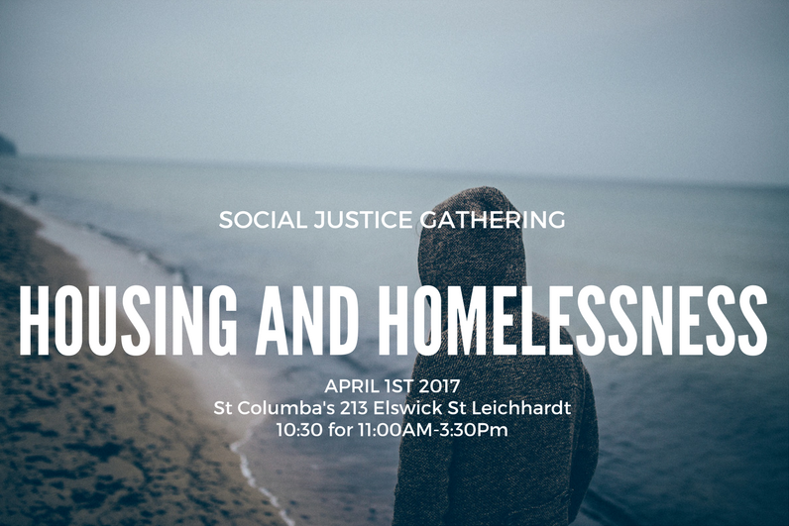

Slide 3
‘The Big Picture’
Professor Peter Phibbs
University of Sydney

Slide 4
Diocesan Whip Around
Who’s in the room?
Sharing our successes and challenges

Slide 5
Sharing Stories of Homelessness
Barry Anderson
Cana Communities

Slide 7
Panel
‘Challenges and Solutions’
Dr Louise Crabtree – Western Sydney University
David Barrow – Sydney Alliance
Dr Judy Yates – University of Sydney
Dr Joanne Jakovich – Big World Homes

Slide 8
Parish Connections
______
Small Groups
At Deanery tables get to know each other. Introduce yourselves; share a little about your social justice work; why you care about social justice; what issues you care about; do you have plans or a desire to work on housing or homelessness issues?

Slide 9
Action Commitments
________________________
Small Group and Plenary
What one action will you commit to doing in the next 6 months? This might be across parishes if you have just discovered shared interests or it might still be within your own SJ group/parish. You’ve heard many ideas for taking action today – will you commit to a campaign? Is there a conversation or two you need to have with key people? Do need to find out what’s happening in your local community? Visit an MP? Volunteer somewhere? Maybe you’ll start a social justice group if you don’t have one?
PICK ONE THING YOU CAN REALISTICALLY DO AND WILL COMMIT TO TODAY – WRITE IT DOWN.

